Slide 1
WALKING LIGHT

Slide 2
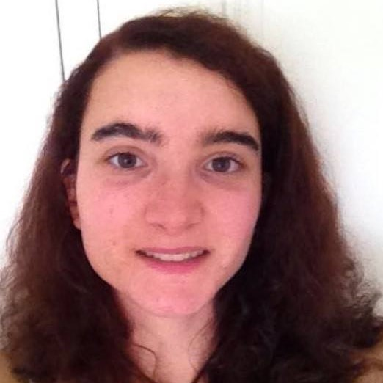
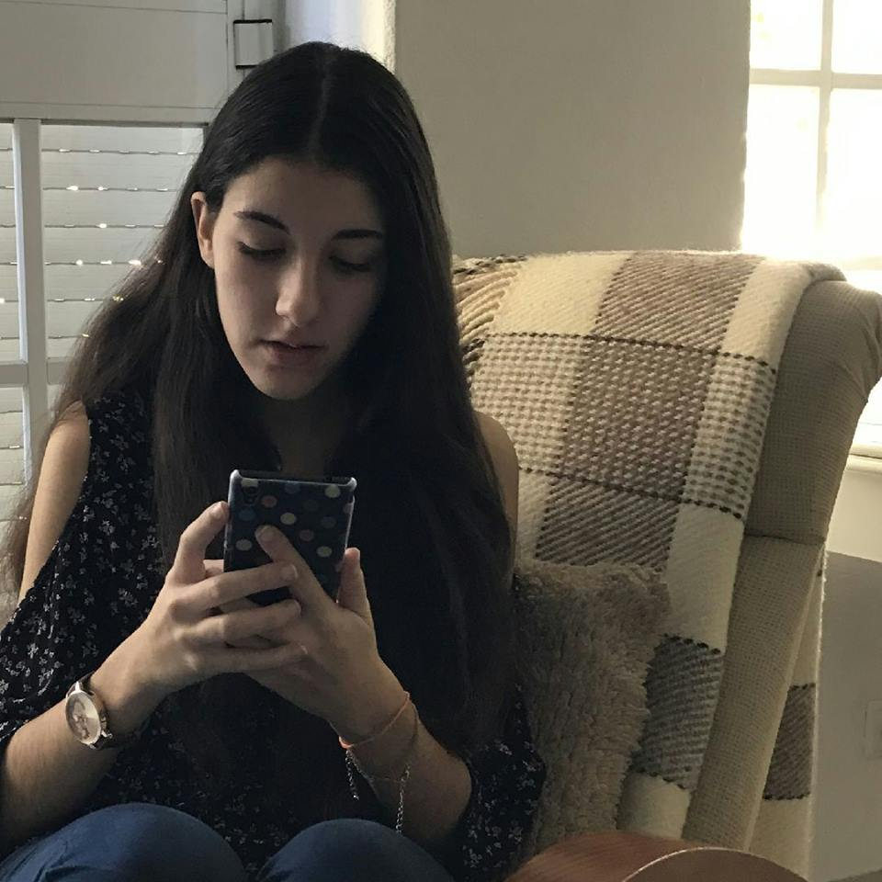
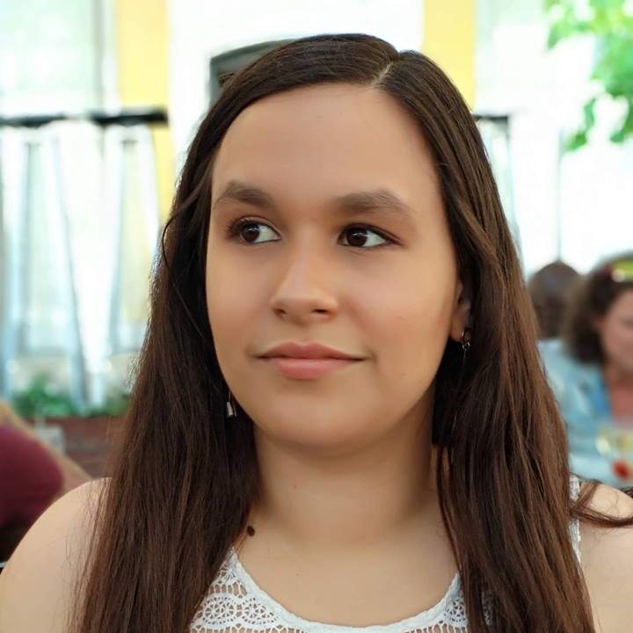
Bárbara Ramalho
GROUP MANAGER
Mafalda Morgado
RESEARCHER
Nádia Mourão
DESIGNER

Slide 3

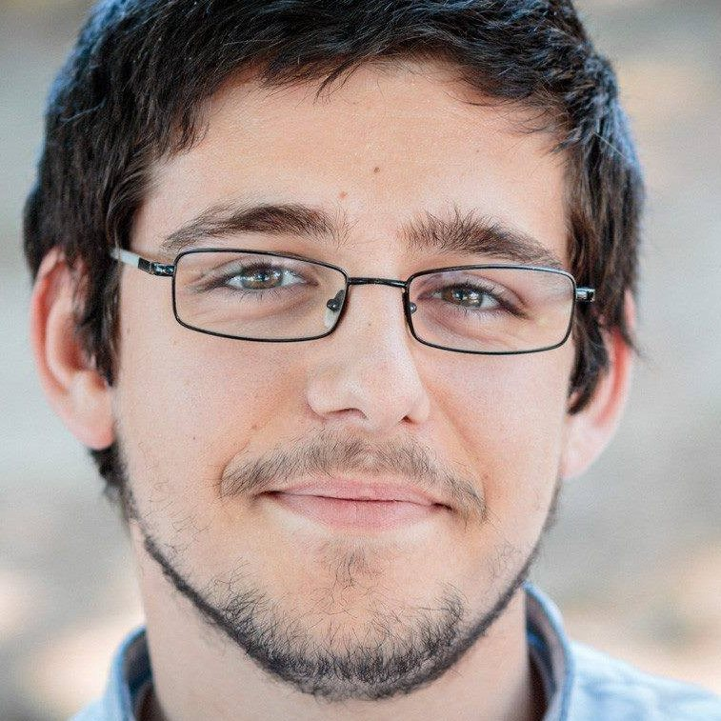
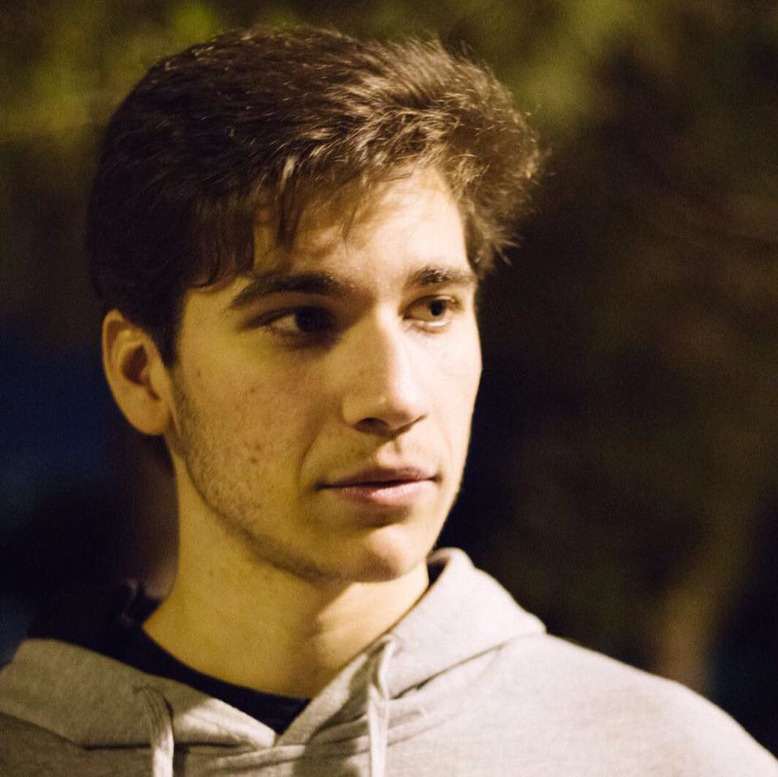
Carolina Veloso
FRONT-END DEVELOPER
Hugo Lencastre
BACK-END DEVELOPER
André Vieira
BACK-END DEVELOPER

Slide 4
SOLUTION CONCEPT

Slide 5

INTERACTIVE PLATFORM

Slide 6

COLOUR CODE
Green
Valid Ticket
Orange
Red
Invalid Ticket

Slide 7


PLATFORM – ARRIVAL

Slide 8
PLATFORM – GOING TO VALIDATE

Slide 9
PLATFORM - VALIDATING

Slide 10
PLATFORM - VALID

Slide 11
PLATFORM – WALK FREELY

Slide 12
INVALID TICKET

Slide 13
PLATFORM – FAILS TO VALIDATE

Slide 14
PLATFORM - INVALID

Slide 15
TIME OUT

Slide 16
PLATFORM – ARRIVAL

Slide 17
PLATFORM – 1 MINUTE LATER

Slide 18
USER STEPS OUTSIDE THE PLATFORM

Slide 19
PLATFORM – VALID

Slide 20
PLATFORM – STEPS OUT

Slide 21
PLATFORM – VALIDATION REQUIRED

Slide 22
LEAVING THE TRAIN

Slide 23
PLATFORM – PEOPLE WAITING

Slide 24
PLATFORM - LEAVING THE TRAIN

Slide 25

TICKET INSPECTORS

Slide 26
PLATFORM

Slide 27

IMPROVEMENT

Slide 28
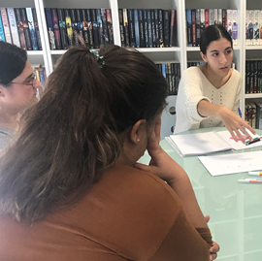

VALIDATION AND IMPROVEMENT
Validate $→$ User research
interviews
focus groups
formative user studies
usability
Improve $→$ design iterations

Slide 29

FEEDBACK
Main reason why people don’t validate
Because they forgot or were in a hurry

Slide 30
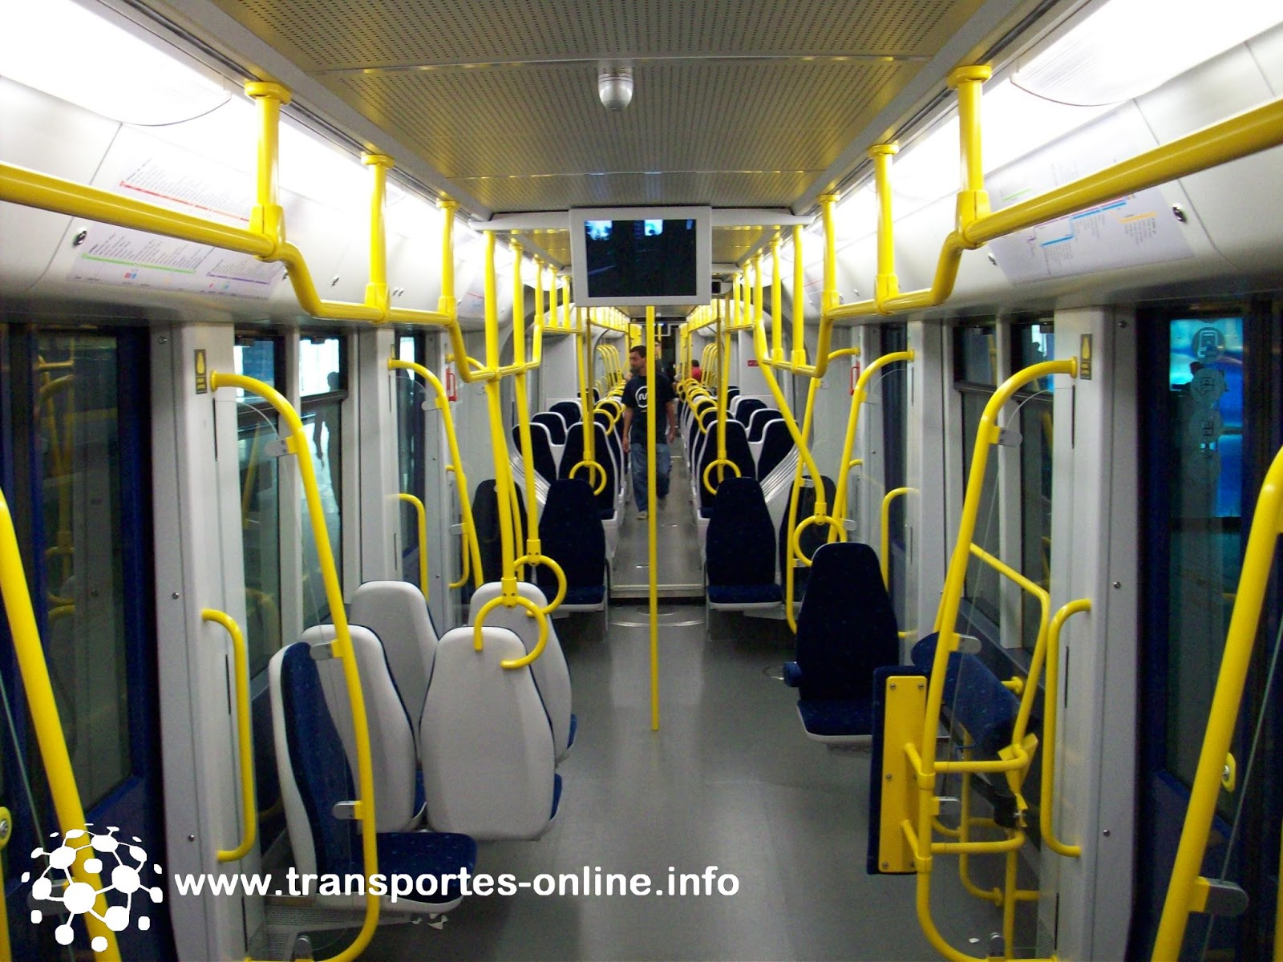

ADDITIONAL VALIDATORS

Slide 31
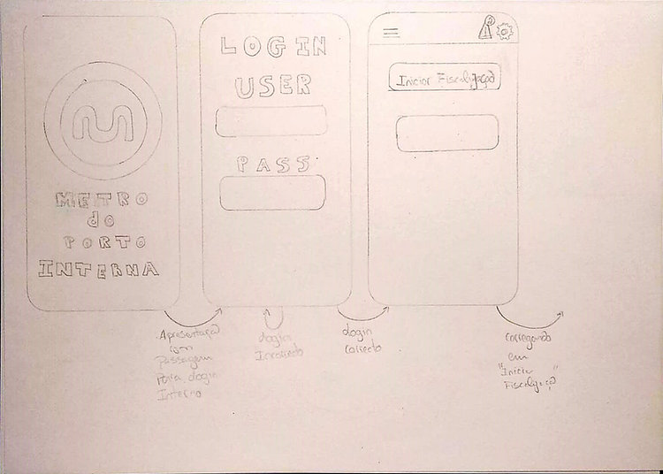
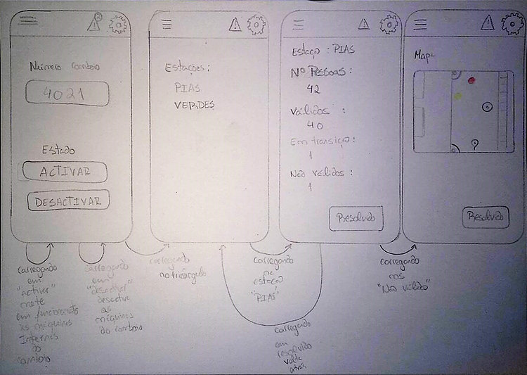
App sketches

Slide 32

USER RESEARCH

Slide 33

OUR GOAL?
Understand our users.

Slide 34
USER RESEARCH
Enquiry
Field observations
Flash Interviews
One-on-one interviews
Focus groups

Slide 35


FARE-EVASION
When they do it
Fear
Anxiety
When they see it
Bothered
Judgmental
Indifferent

Slide 36
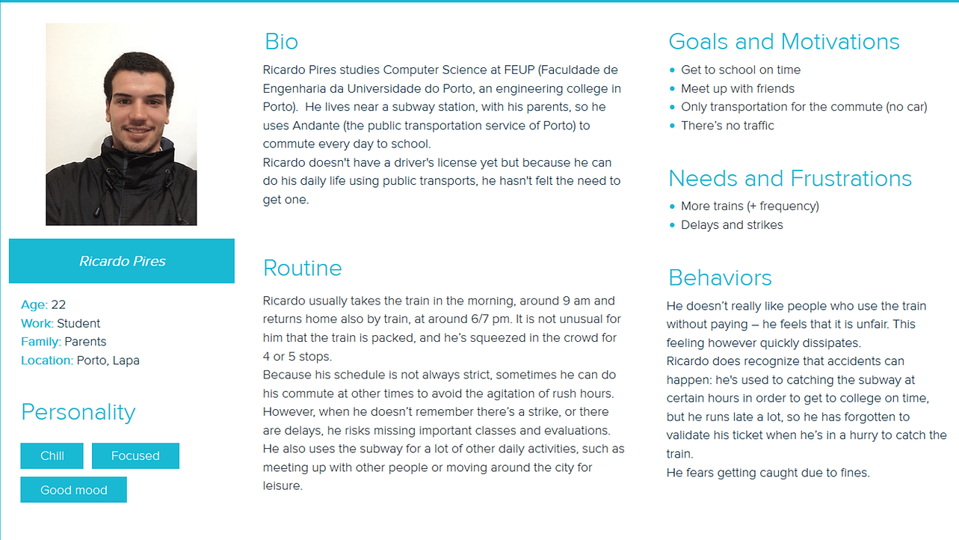
PERSONA

Slide 37
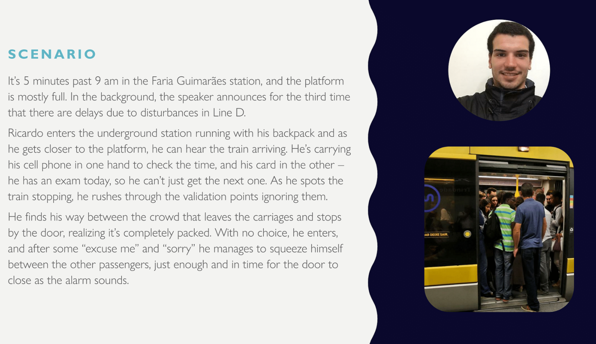
SCENARIO

Slide 38
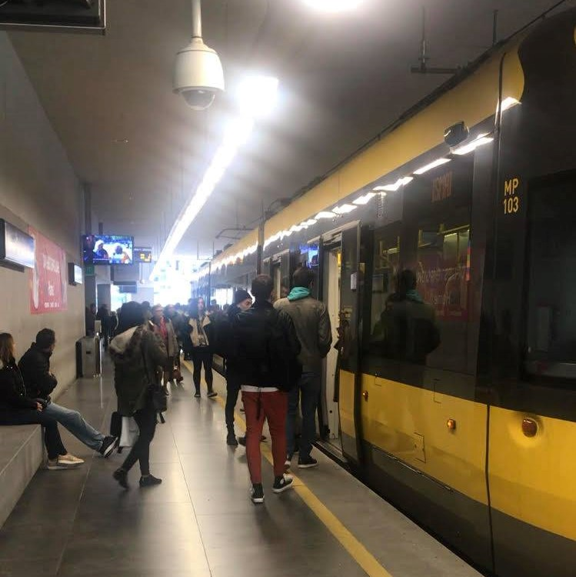
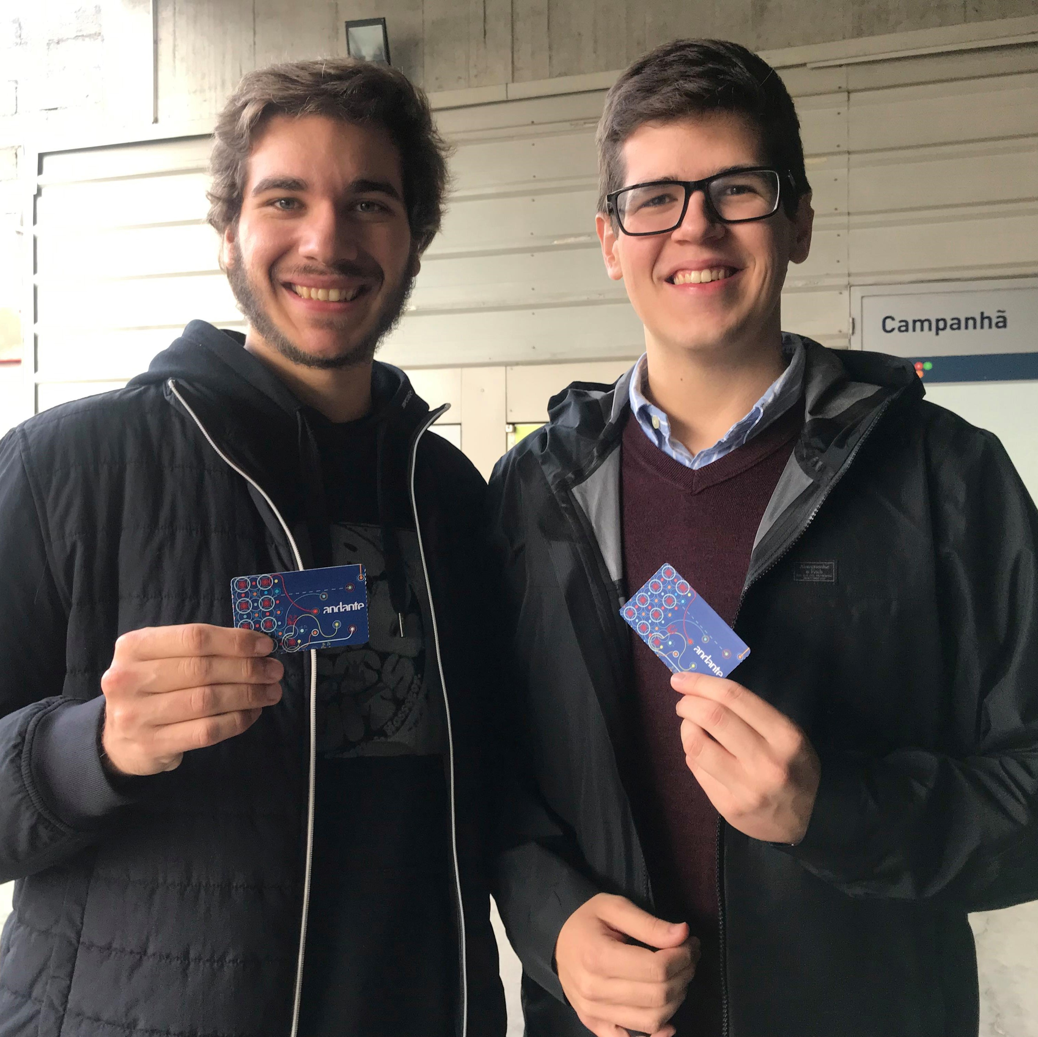
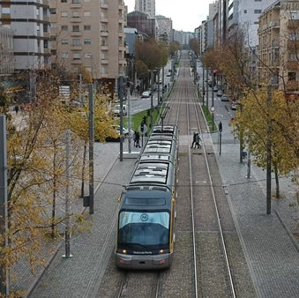
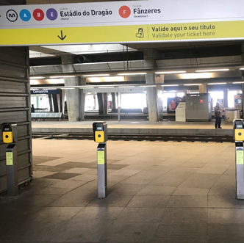
WE ALSO WENT TO PORTO

Slide 39

DESIGN PROCESS

Slide 40


DESIGN PROCESS
TESTING
REFINING

Slide 41
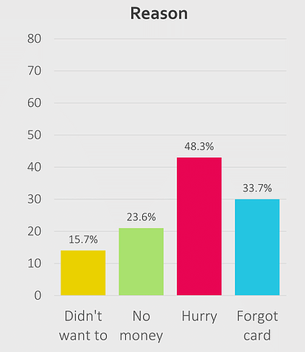
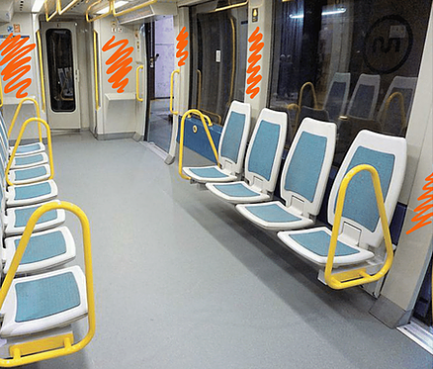



EXAMPLES
Inside
validators

Slide 42
BUDGET SKETCH

Slide 43
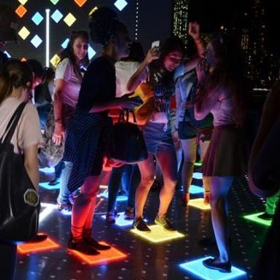
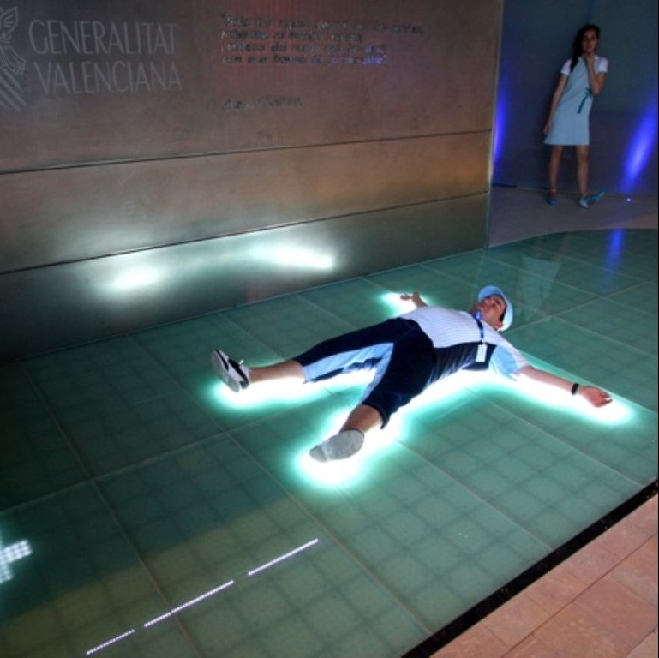
TWO MAIN IDEAS
BRIGHTLOGIC
SENSACELL

Slide 44
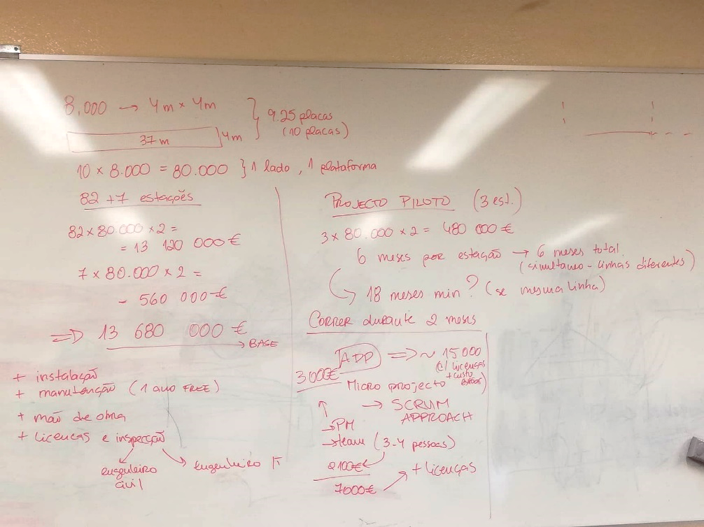









BUDGET OVERVIEW
Maintenance
Employees
Licensing and inspections

Slide 45

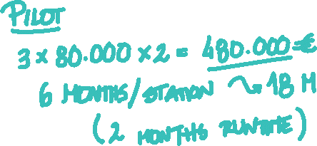


PILOT & APP

Slide 46
DELIVERABLES
as-is

Slide 47
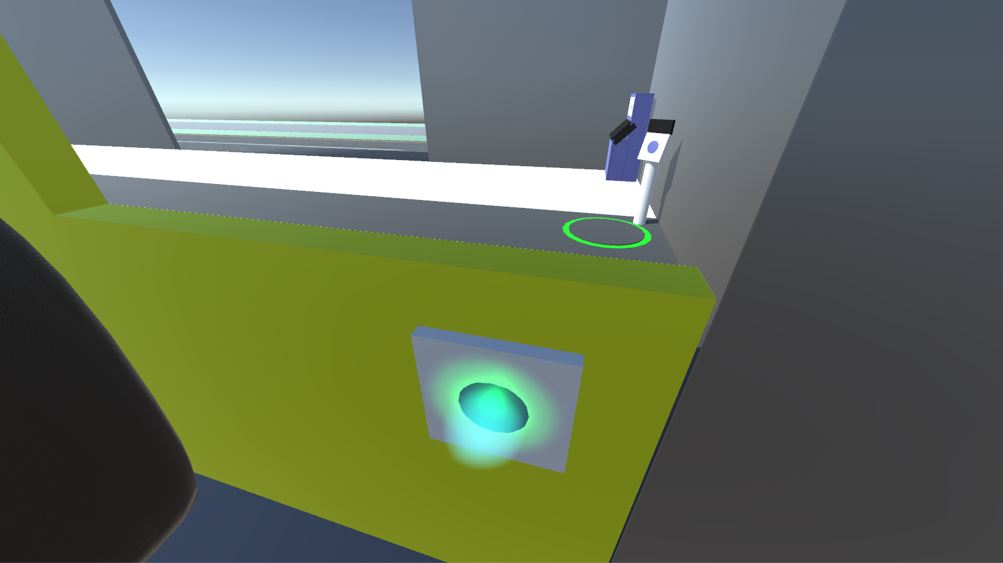
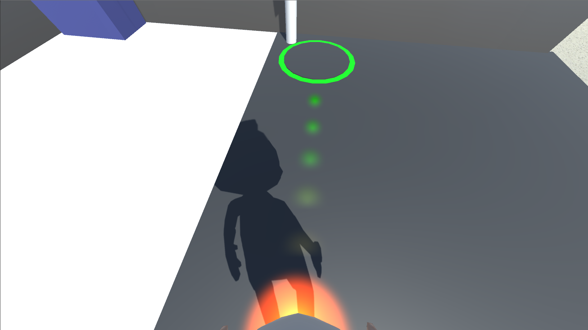
DELIVERABLES
Unity Simulation

Slide 48
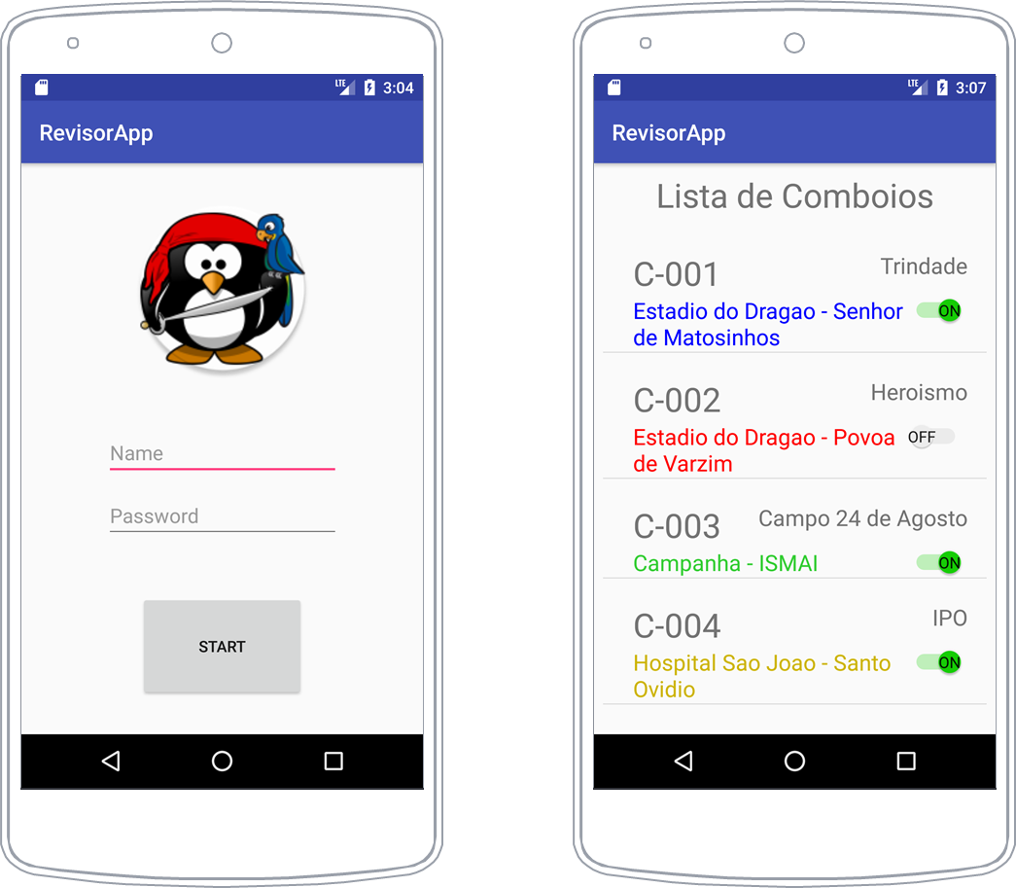
DELIVERABLES
App

Slide 49
Thank you!
ANY QUESTIONS?
You can find us at:
https://walkinglight.wixsite.com/ccu-group7

